Slide 1

MACHINE LEARNING WITH THUNKABLE APP
By : Delveer Singh

Slide 2
What we will be covering today:
1)Using Thunkable
2)Image Recognition
2)Speech recognition
3)Bluetooth communication with the Arduino.
4)Using the pedometer

Slide 3
Short Intro…
Why Thunkable:
No coding experience required.
It is simply drag and drop.
Gives the idea and thought process.
Easy to use

Slide 4
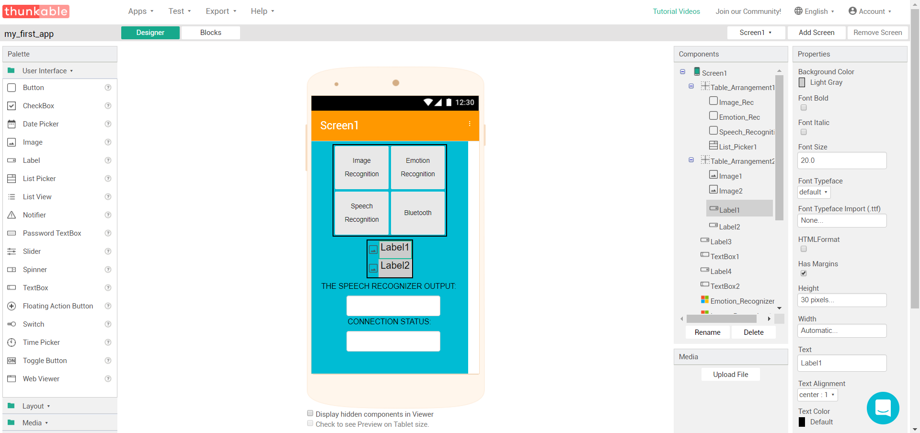
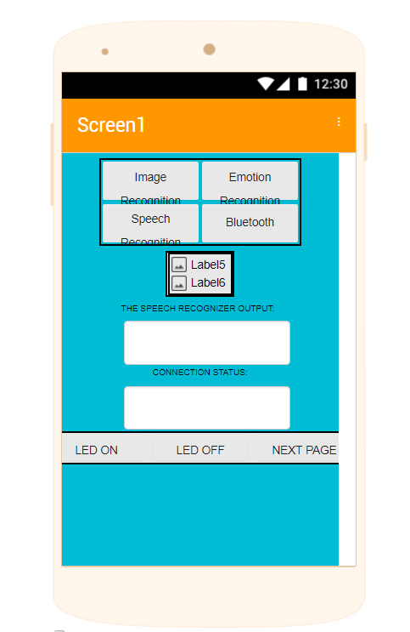
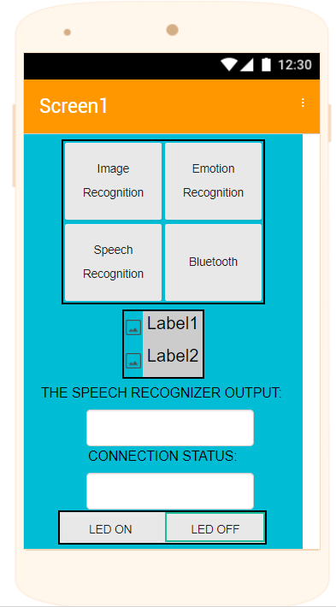
Using Thunkable
Items to select and place into the app.
The editor to preview how the design looks
The component editor
This is to adjust the elements in the
components tab

Slide 5
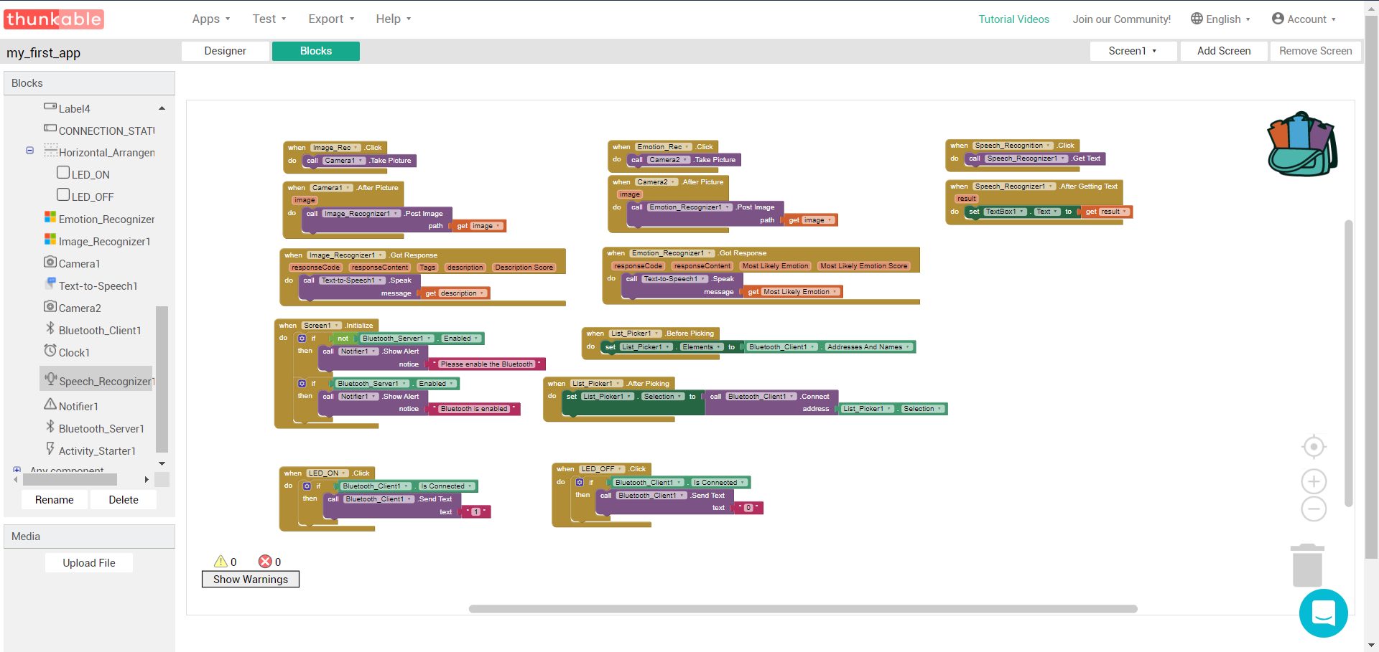
Using Thunkable
Things we can use to program
Block editor for us to use and program. Note that the blocks appear for drag and drop when we click things in the Blocks column

Slide 6
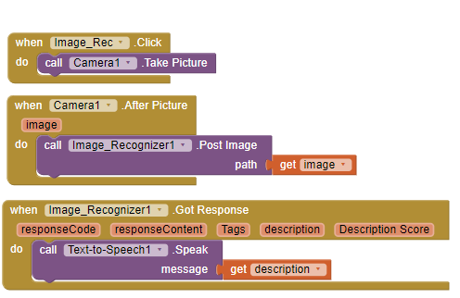
Image Recognition
When we click a button take a picture
After taking the picture, send it to the image recognition API.
Get the description back from the API

Slide 7
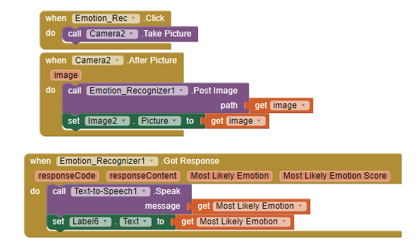
Emotion detection
Initialises the camera and takes a photo.
Sends the picture to the image on the first page and sends image to the emotion API.
Speak out the message and update the label.

Slide 8
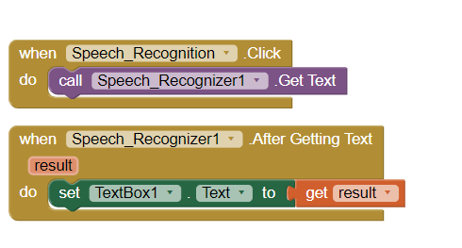
Speech Recognition
When clicked, calls the speech recognizer
Update the textbox with the result

Slide 9
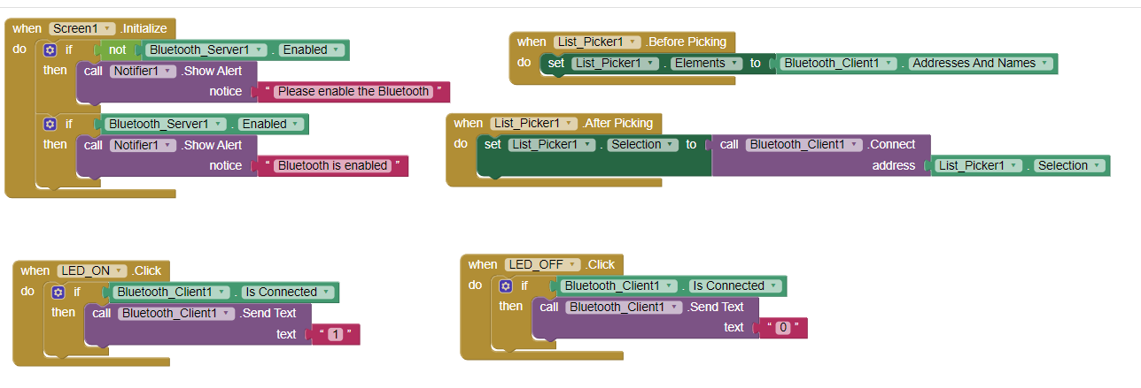
Bluetooth Communication with the Arduino
Lists all of the devices that we can connect to
This is just to ensure Bluetooth is enabled on the phone when screen is initialised
Connect to the address we selected
When this button is clicked, sends a “1”
When this button is clicked, sends a “0”

Slide 10
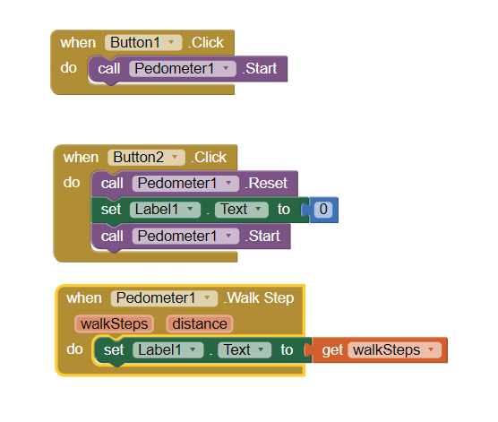
Using The Pedometer
When the start button is clicked,
Start the pedometer
Reset and restart the pedometer
When a step is made, update the label to get the number of steps

Slide 11
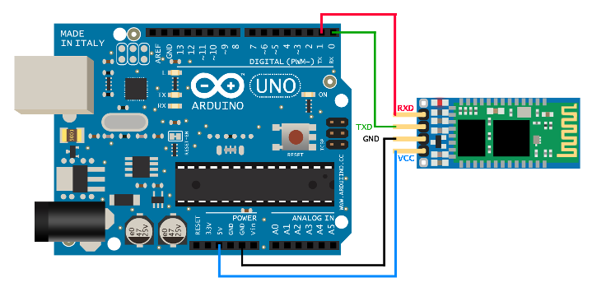
Bluetooth Communication with the Arduino
Make sure you connect the Bluetooth Module like this:

Slide 12
Bluetooth Communication with the Arduino
Great! Now, We need to program the Arduino and LED’s to use the data sent via Bluetooth to do something.
Open Up the Arduino IDE
Then, Follow me.

Slide 13
Test What you have made
Login into the Thunkable app
Connect to your project
Test to see if it works
There you have it!

Slide 14
Thank You!!

